Slide 1

Decentralized Trading Platform
Presented by: Samuel Apakuki Nayacakalou, Flora Zhao, Md Muhasenul Haque

Slide 2
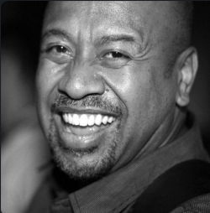
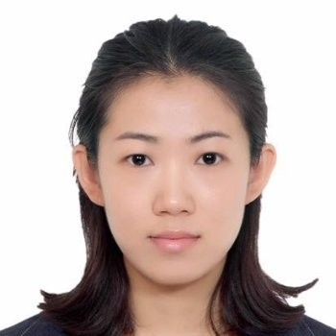
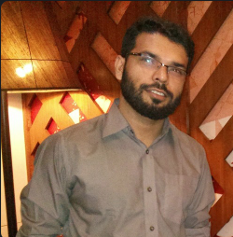
Team 1 Project 3
Samuel Apakuki Nayacakalou, Flora Zhao, Md Muhasenul Haque

Slide 3
FILE STRUCTURE AND DEPLOYMENT
Files
Back End: .env File/.sol File/.json File
Front End: app.py
Readme & PPT
Deployment and Execution
Compile Exchange.sol, FixedSupplyToken.sol
Copy ABI to ‘./compiled/Exchange_abi.json’ and ‘./compiled/FixedSupplyToken_abi.json’
Deploy Smart Contracts: Exchange and FixedSupplyToken
Run app.py: streamlit run app.py

Slide 4
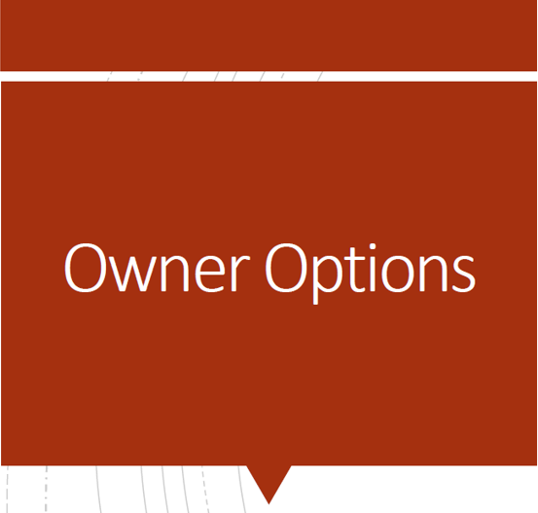
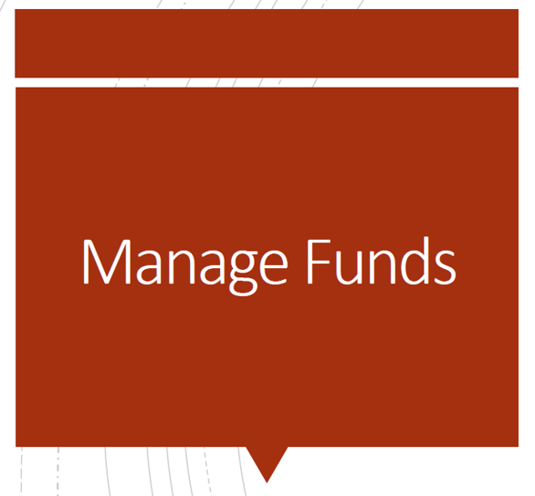

FUNCTIONS OF THE DEX
Admins
Users
Add Token
Deposit / Withdraw Ether
Buy Token / Sell Token
Approve Allowance
Deposit / Withdraw Token
Check Order Book

Slide 5
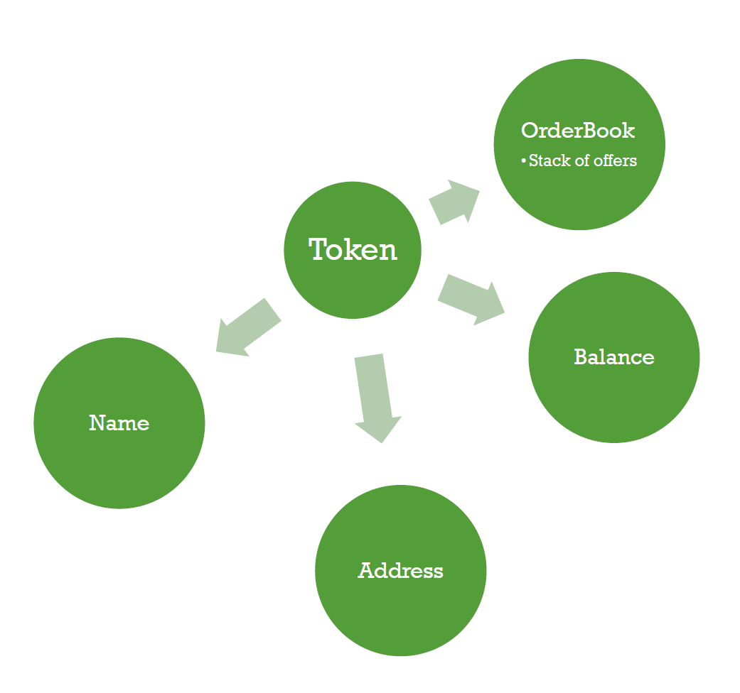
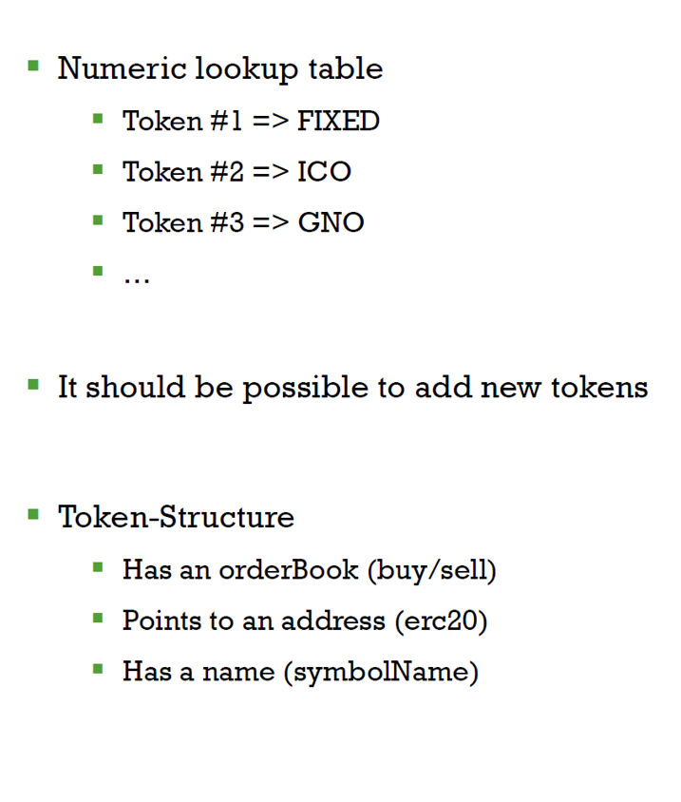
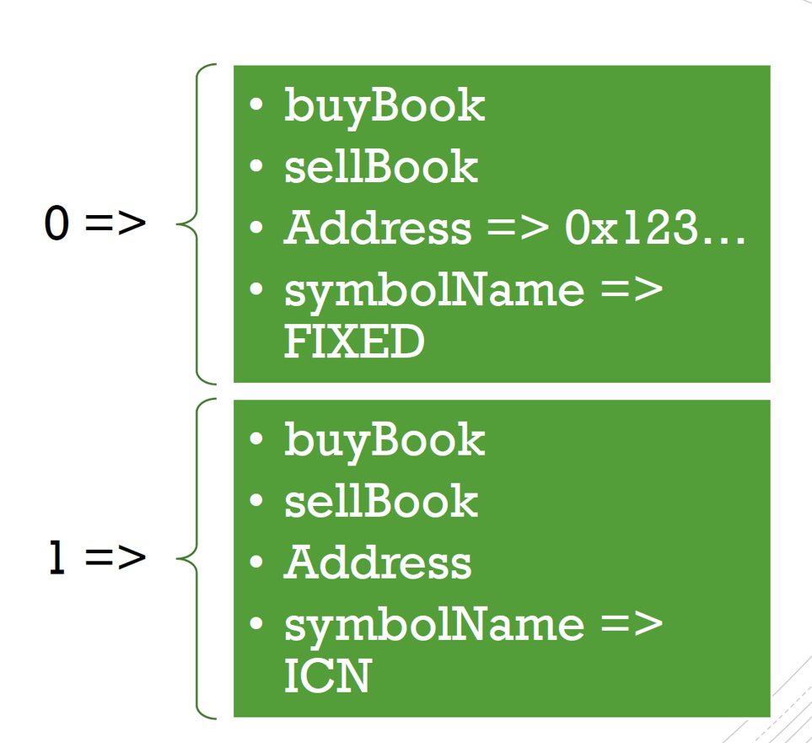
DATA TYPES

Slide 6
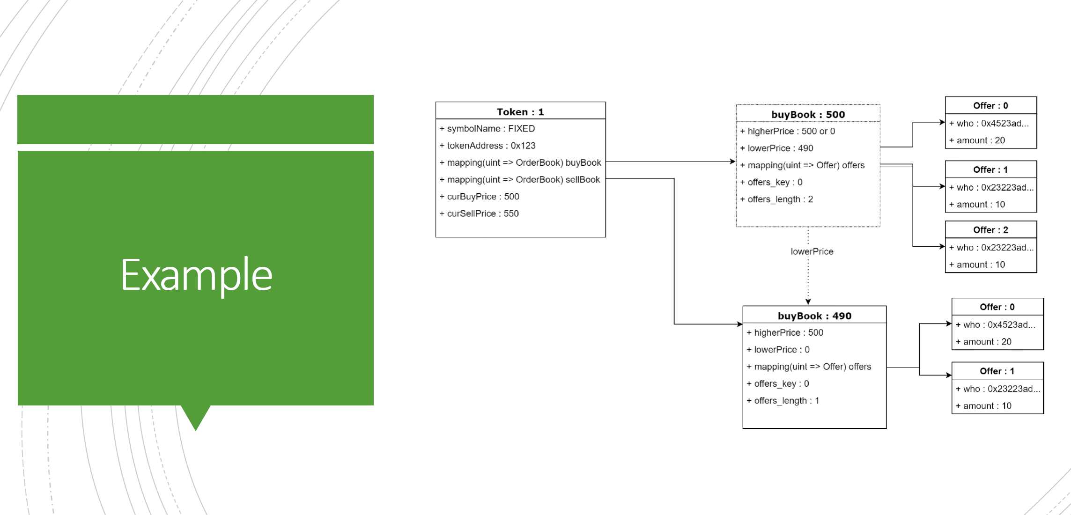
DATA TYPES

Slide 7
DEMO PROCESS – ADMINS
Add Token to the DEX
Approve Allowance for the DEX to transfer tokens on behalf of the token owner

Slide 8
DEMO PROCESS – USERS – FUND MANAGEMENT
Deposit Ether to the DEX
Withdraw Ether to the DEX
Check Ether balance
Deposit Token to the DEX
Withdraw Token to the DEX
Check Token balance

Slide 9
DEMO PROCESS – USERS – TOKEN TRADING
Buy Tokens
Sell Tokens
Check Order Books (Buy Book and Sell Bood)

Slide 10
FUTURE WORK - DEBUGGING
Order partial fulfilment
CASE 1: buy 5@100 sell 4@100 ERROR
CASE 2: buy 4@100 sell 5@100 WORKING WELL

Slide 11
FUTURE WORK – ADDING NEW FEATURES
Add more than one tokens to the DEX
Cancel Order Function
Emits Events : display more info in the front end or enable the user to check convieniently
Display more info in the front end, e.g. Display the allowance for the owner

Slide 12
FUTURE WORK – UI OPTIMIZATION
Sidebar fonts should be bigger
Some input boxes can be deleted when the functions are optimized

Slide 13
FUTURE WORK – OTHER FRONT END SUPPORTED
Truffle version development to support mobile apps

